Slide 1
How has the relationship between pay and productivity in the UK transformed in recent decades?
A study on the commonly held belief that greater productivity will translate to greater living standards.

Slide 2

“
Productivity isn’t everything, but, in the long run, it is almost everything. A country’s ability to improve its standard of living over time depends almost entirely on its ability to raise its output per worker.
- Paul Krugman, The Age of Diminished Expectations, 1990

Slide 3



1990
1956
2024

Slide 4
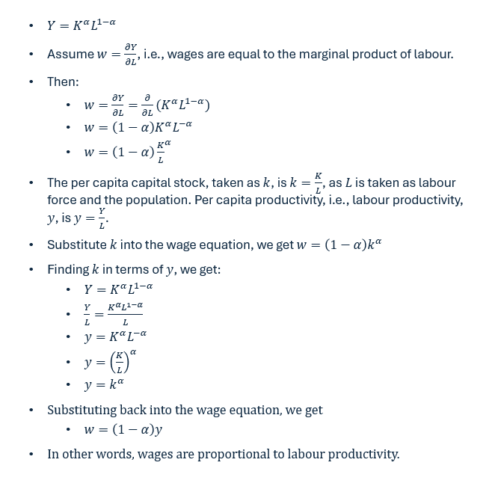
Solow’s Growth Model
A Contribution to the Theory of Economic Growth, 1956. The Quarterly Journal of Economics
Notes:
Cobb-Douglass production technology, where output is determined by a combination of labour and capital.
K is capital, L is labour. Alpha is the capital share of output, 1-alpha is the labour share of output.

Slide 5

Rachel Reeves, Mais Lecture, 2024
“
At root, productivity remains the key medium term determinant of wages. It is the collapse in our productivity growth which explains our wage stagnation.

Slide 6



The ‘coupled’, or ‘linked’, view of wages and productivity
In other words, a rise in productivity will lead to a rise in wages.
On the other hand, we have:

Slide 7
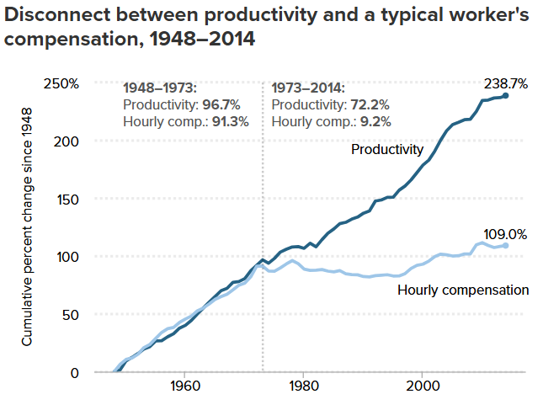
… the ‘decoupled’, or ‘delinked’, view of wages and productivity
The Productivity–Pay Gap
Understanding the Historic Divergence Between Productivity and a Typical Worker’s Pay
Report • By Josh Bivens and Lawrence Mishel • September 2, 2015

Slide 8

Joe Biden, 2024
“
[…] and then along came 1979 and everything began to change. Productivity in the country has grown almost four times faster than pay since 1979. That means that workers have been giving much more to their employers’ bottom lines than they’ve gotten back in their pay-checks.

Slide 9
In the academic world, the topic is not without strong debate. However, to properly engage with the literature, a clarification of terms is first necessary.
First: what is meant by “pay”?

Slide 10
Definitions
Gross earnings, i.e., wages
Total Labour Compensation
Total untaxed income. Seen as more ‘immediate’ than total compensation.
Includes gross earnings, plus other payments, such as bonuses, pension contributions, etc.
With that understood…

Slide 11
Second: which kind of pay is most important?

Slide 12
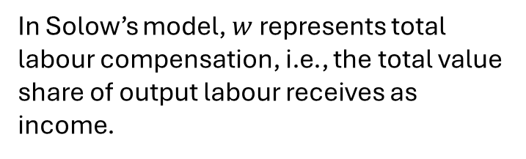
Recall the three original proponents of the ‘linked’ view mentioned.
“A country’s ability to improve its standard of living […]”
“[…] this has had serious consequences for living standards […] productivity remains the key medium term determinant of wages […]”
In Solow’s model, $w$ represents total labour compensation, i.e., the total value share of output labour receives as income.

Slide 13
These views all represent productivity linked with different variables.
Median gross earnings.
Median and average earnings.
Total labour compensation

Slide 14
Recall this graph – what is meant by “typical worker’s pay”?
The Productivity–Pay Gap
Understanding the Historic Divergence Between Productivity and a Typical Worker’s Pay
Report • By Josh Bivens and Lawrence Mishel • September 2, 2015

Slide 15
The Productivity–Pay Gap
“average hourly compensation of production/nonsupervisory workers in the private sector”
Note: Data are for average hourly compensation of production/nonsupervisory workers in the private sector and net productivity of the total economy. "Net productivity" is the growth of output of goods and services minus depreciation per hour worked.

Slide 16
This study will not restrict its investigation to one income measurement.
Median and average gross earnings, and total labour compensation, are investigated with respect to productivity.
The UK does not collect data on ‘production/non-supervisory’ worker pay, but this is approximated by the median gross earnings rate.
Notes:
The baseline analysis will focus on median wages are these are closely linked to standard of living.

Slide 17
The state of productivity-pay divergence in the UK
Looking at hourly median gross earnings.

Slide 18
The state of productivity-pay divergence in the UK
Looking at all earnings.

Slide 19
There is clearly heterogeneity.
Median earnings, which more closely reflect a typical worker’s income than average earnings, have diverged significantly from productivity.
Average earnings and average total labour compensation (ATLC), have more closely followed productivity.
ATLC growth has exceeded productivity growth.

Slide 20
Pessoa & Van Reenen, 2013. Decoupling of Wage Growth and Productivity Growth? Myth and Reality
Net vs. Gross Decoupling
Net Decoupling: divergence between productivity and ATLC.
Gross Decoupling: divergence between productivity and median earnings.
They argue that net decoupling is mostly non-existent, whereas trends from at least the early 1990s show gross decoupling.
Findings confirmed by Teichgraeber & Van Reenen (2022), when self-employment is more carefully considered.

Slide 21
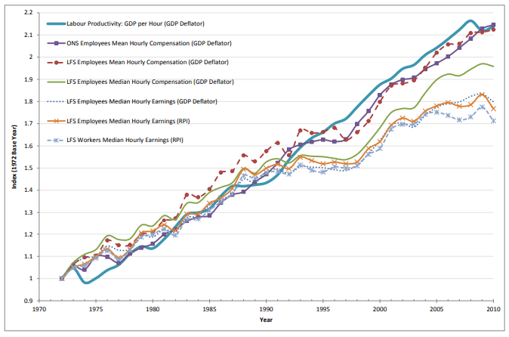
Pessoa & Van Reenen, 2013. p. 15, fig. 6
Divergence

Slide 22
Ciarli, Salgado & Savona, 2018. Do Low-Wage Workers Benefit from Productivity Growth?
Quantitative analysis of productivity elasticities of wages.
In 2011-2015, a 1% growth in labour productivity led to either an insignificant, 0.151%, and 0.225% increase in median wages at the firm, industry, and local labour market levels, respectively.

Slide 23
Ciarli, Di Ubaldo & Savona, 2021. The weak link between productivity and wages in London
Quantitative analysis of productivity elasticities of wages in London, Heathrow and Slough, and the rest of Great Britain.
A £1 increase in productivity led to a £0.35 and £0.26 increase in median wages, across a 5-year and 10-year time horizon, respectively.
There was probably a typo in the study, these results are instead probably 1%, 0.35%, and 0.26%, as variables were logged prior to regression.

Slide 24
Combined, this evidence indicates strong decoupling between median wages and productivity. Average wages and ATLC fare better, but this appears to be indicative of rising inequality and stagnating living standards rather than anything positive.

Slide 25
However, the debate is far from settled. There are methodological issues with these studies that I have identified which complicate their conclusions. When combined with other, similar studies from the US, a gap is clearly identified where some novel analysis could be of major benefit.

Slide 26
Pessoa & Van Reenen, 2013. Decoupling of Wage Growth and Productivity Growth? Myth and Reality
Teichgraeber & Van Reenen, 2022. Have Productivity and Pay Decoupled in the UK?
These are forms of qualitative, rather than quantitative analysis.
They point and analyse visual divergence, which has its uses. But it is less effective when discussing whether relationships have broken down or not.

Slide 27
Ciarli, Salgado & Savona, 2018. Do Low-Wage Workers Benefit from Productivity Growth?
Ciarli, Di Ubaldo & Savona, 2021. The weak link between productivity and wages in London
These regressions do not consider time lags.
The 2018 paper acknowledges this, but the problem is not rectified in the 2021 paper. These effects are important, as pointed out by the authors and later studies.

Slide 28
How can these problems be remedied for fuller analysis?
Stansbury & Summers (2018) and Brocek (2019) provide the clearest examples.
Both incorporate lags and controls in a quantitative analysis.
Stansbury & Summers (2018) investigate the link between productivity and average and median total labour compensation, and production/non-supervisory wages, as well as the rest of the income distribution, in the US.
Brocek (2019) investigates the link between median wages and productivity, as well as more parts of the income distribution, in the UK

Slide 29
Findings
Stansbury & Summers (2018) find that the elasticity of productivity on average and median wages is, at the 95% confidence level, not significantly different from one-to-one.
In other words, they find that a 1% rise in productivity will, all else equal, cause a 0.72% rise in median total labour compensation on average, with a standard deviation of 0.17%.
Brocek (2019) reports similar findings and is not able to reject a one-to-one relationship at the 95% confidence level.
For a 1% increase in productivity, the median wage will rise 1.54% on average.

Slide 30
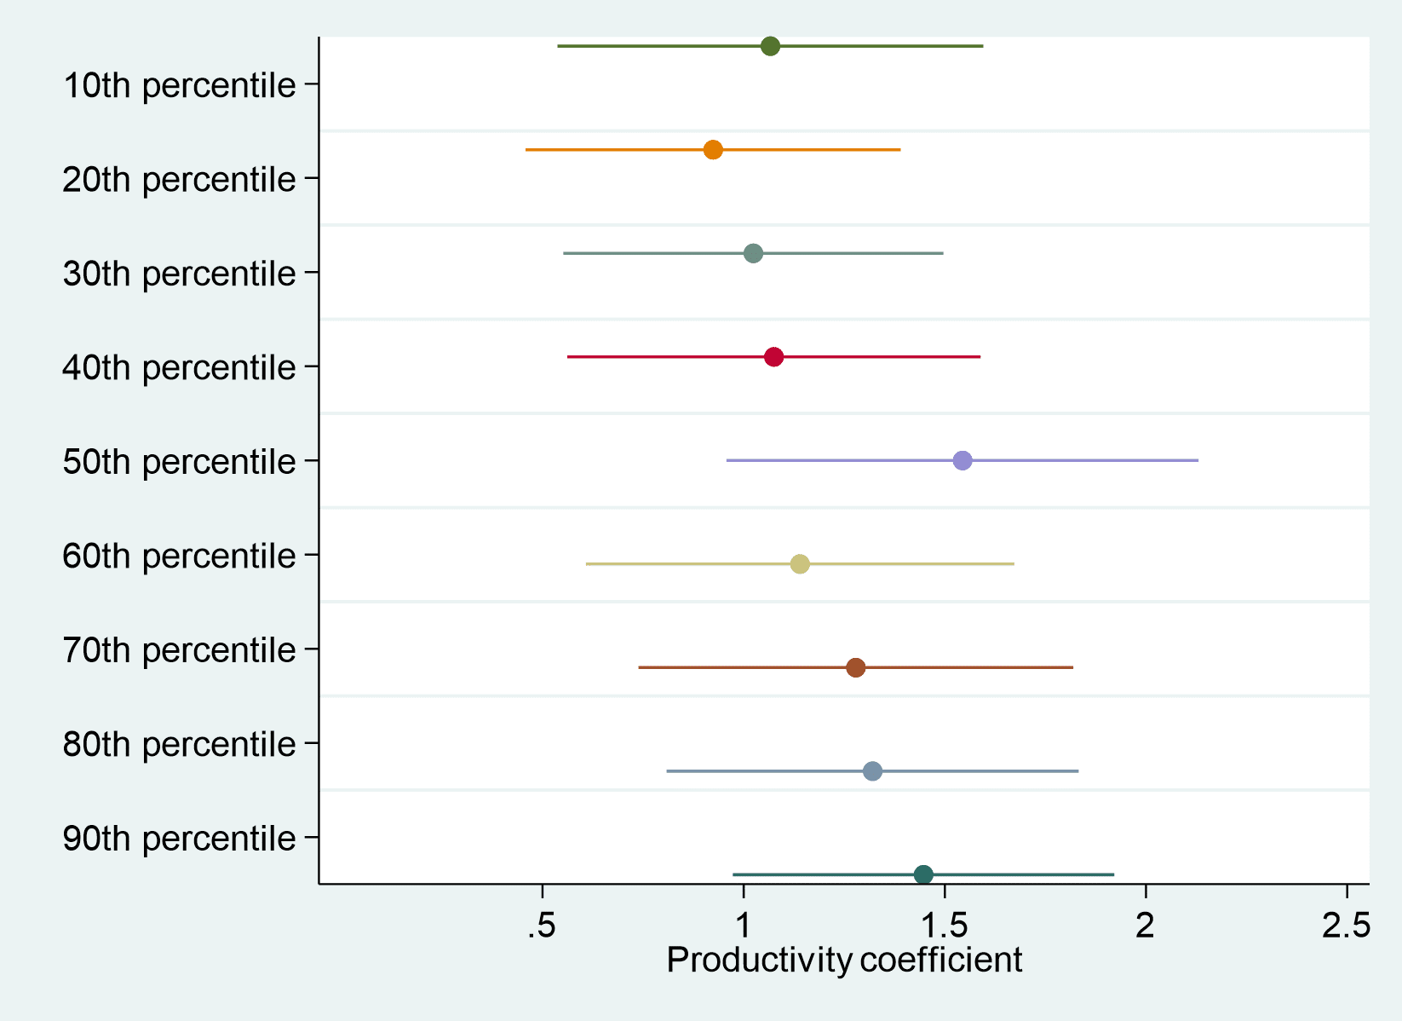
Brocek (2019) approaches a good level of analysis, however there are still problems.
The timeframe only spans from 1999-2017. More can data can be accessed to expand the number of observations, increase confidence in estimates, and add value.
Brocek (2019) does not undergo any robustness checks, or expand his analysis to examine average wages or ATLC.
Notes:
Analysis is also very informal. It is a blogpost, and no regression tables are included which allow a more thorough analysis of coefficients, standard deviation, R^2, etc.

Slide 31
Empirical Strategy
Empirical Strategy mirrors Brocek (2019) and Stansbury & Summers (2018)
Regressing wages on productivity
Median and average wages, and ATLC, will be dependent variables.
Analysis will be further extended to find effects of productivity across the income distribution.
Time period 1997-2019 is analysed at baseline.
Backdated to 1987 to test for robustness of estimation.
Lagged effects are accounted for, control variables are taken from the literature.

Slide 32
Why might lagged effects be important?
Firms may postpone wage increases to gain a competitive advantage,
Firms must discern how much labour productivity contributed to increased output.
Notes:
firms may postpone wage increase to gain a competitive advantage or to recover from losses, and Stansbury & Summers (2018) point out that lagged effects may exist because firms take time to discern to what extent increases in output are due to labour productivity.

Slide 33
Which variables need to be controlled for?
Unemployment
Inflation
1. Reduction to worker bargaining power reduces income,
2. Labour productivity tends to rise in recessions as less productive parts of the workforce are laid off and firms make do with less (Lazear, Shaw & Stanton, 2012)
1. Conflict theories of inflation suggest wage-price or price-wage spirals may arise during inflationary periods.
2. Labour productivity may fall as inflation distorts the efficient allocation of capital away from productive sectors (Mishkin & Posen, 1997)
Notes:
(Lazear, Shaw & Stanton, 2012): Why productivity rises during recessions,
(Mishkin & Posen, 1997): Inflation targeting: lessons from four countries.

Slide 34
Baseline Model
$$Δlog{wages_{t}=β_{0}+β_{1}Δlog{prod_{t}+β_{2}Δunemp_{t}+β_{3}Δunemp_{t−1}+β_{4}Δinf+ε_{t}}}$$
Unemployment and inflation are not logged as they are measured in percentages
Variables are logged to calculate elasticities and differenced to ensure stationarity.
(Standard stationarity tests were run)

Slide 35
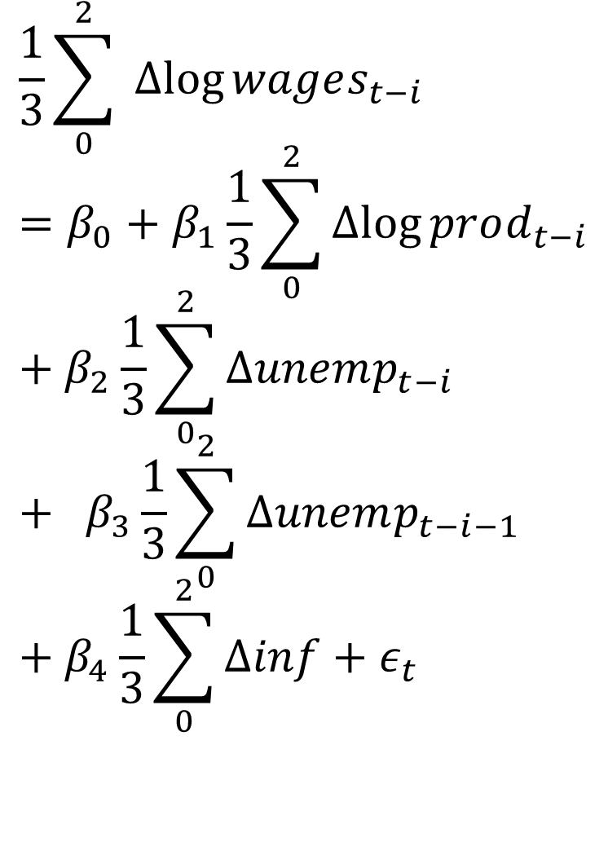
Accounting for lagged effects
$$\frac{1}{3}\sum_{0}^{2}{ Δlog{wages_{t−i}}}=β_{0}+β_{1}\frac{1}{3}\sum_{0}^{2}{Δlog{prod_{t−i}}}+β_{2}\frac{1}{3}\sum_{0}^{2}{Δunemp_{t−i}} + β_{3}\frac{1}{3}\sum_{0}^{2}{Δunemp_{t−i−1}}+β_{4}\frac{1}{3}\sum_{0}^{2}{Δinf}+ε_{t}$$
Variables are estimated in 3-year moving average form to account for lagged effects.

Slide 36
Data
Variable data is varied to allow for robustness tests.
Median Total Labour Compensation is not available in the UK.
2015 prices
2019 prices
Notes:
Different price bases do not affect final regression results as year-on-year percentage changes are independent of index base year.

Slide 37
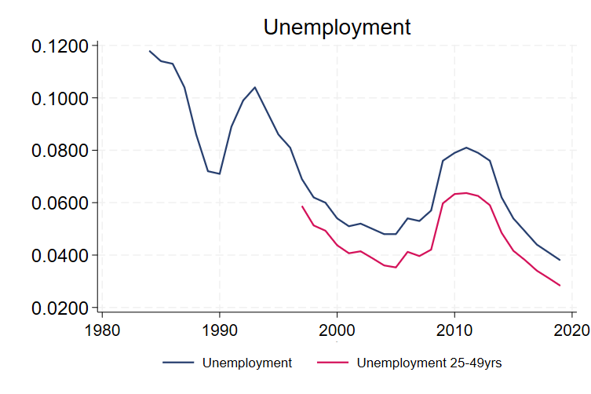
Data
Some data shown dates before 1997.

Slide 38
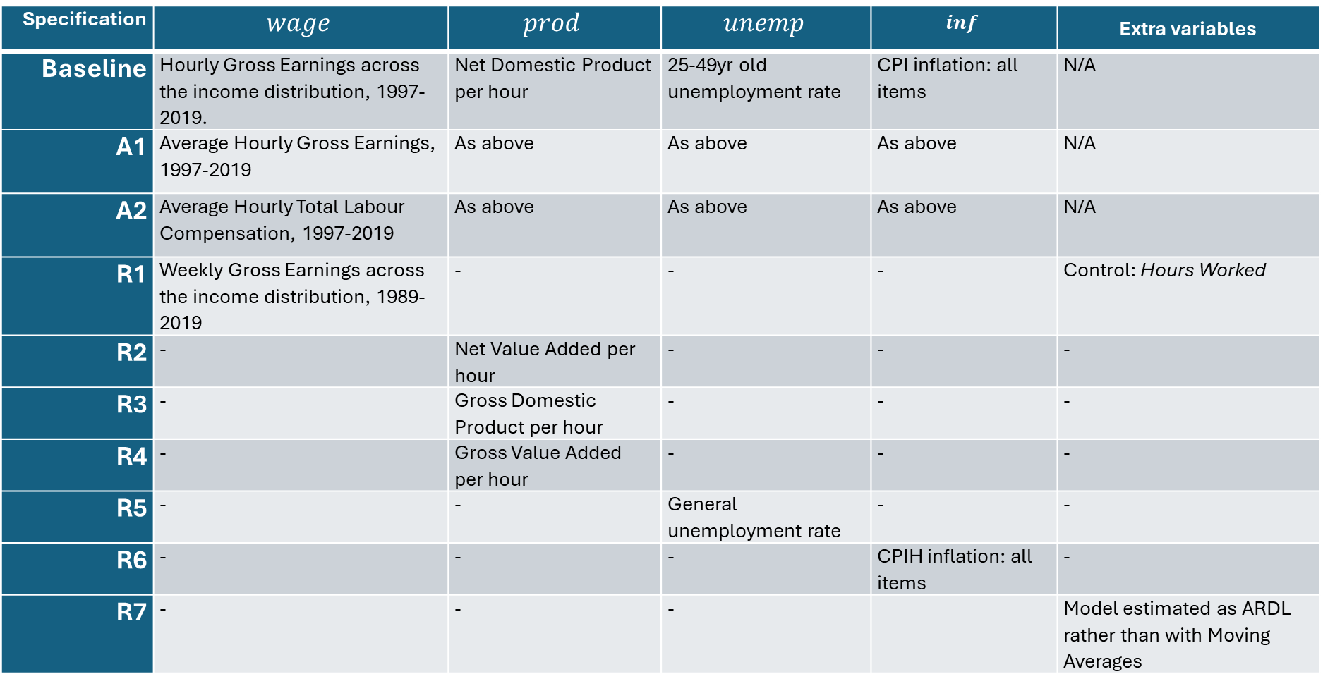
Specifications recap
Specification | $$wage$$ | $$prod$$ | $$unemp$$ | $$inf$$ | Extra variables
Baseline | Hourly Gross Earnings across the income distribution, 1997-2019. | Net Domestic Product per hour | 25-49yr old unemployment rate | CPI inflation: all items | N/A
A1 | Average Hourly Gross Earnings, 1997-2019 | As above | As above | As above | N/A
A2 | Average Hourly Total Labour Compensation, 1997-2019 | As above | As above | As above | N/A
R1 | Weekly Gross Earnings across the income distribution, 1989-2019 | - | - | - | Control: Hours Worked
R2 | - | Net Value Added per hour | - | - | -
R3 | - | Gross Domestic Product per hour | - | - | -
R4 | - | Gross Value Added per hour | - | - | -
R5 | - | - | General unemployment rate | - | -
R6 | - | - | - | CPIH inflation: all items | -
R7 | - | - | - |  | Model estimated as ARDL rather than with Moving Averages

Slide 39
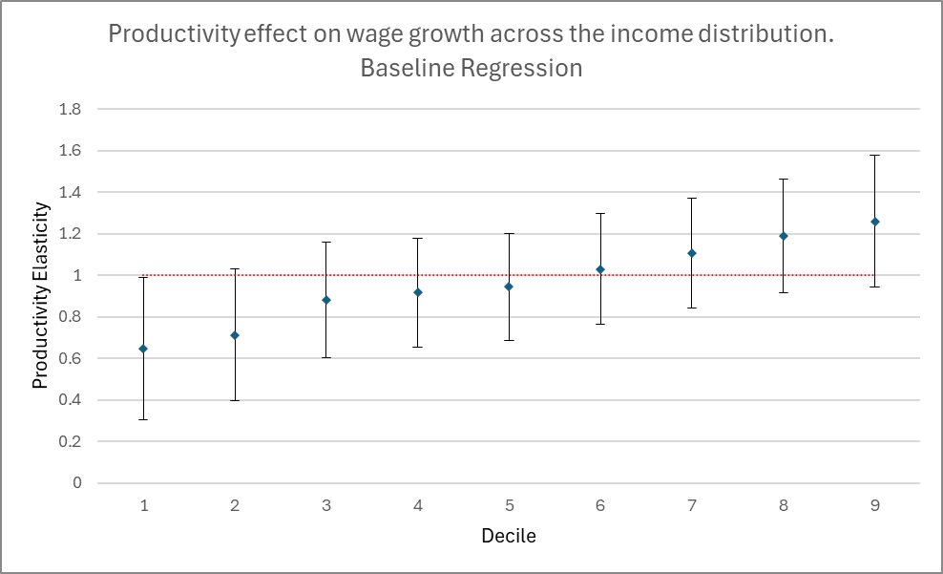
Results – Baseline

Slide 40
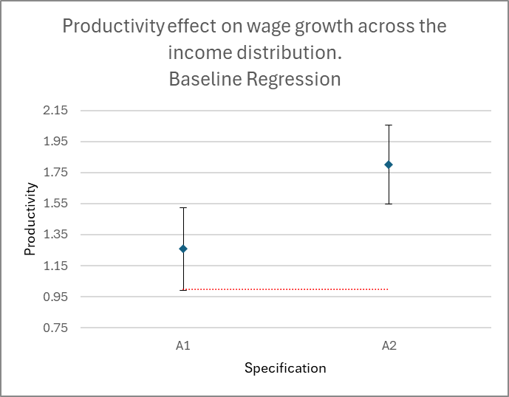
Results – Alternate Specifications

Slide 41
Main Findings
There is strong correlation between wage growth and productivity, at both the average and median levels.
The ‘linkage’ or ‘coupled’ assertion made by Krugman, Reeves, and Solow are supported by the evidence.
Introducing lagged effects is both theoretically justified and produces significant, positive results.
Unemployment and inflation also have significant effects on wage growth.

Slide 42
Main Findings
Inequality effects are significant – lower income deciles benefit less on average, via wage growth, from average labour productivity growth.
For most of the income distribution, productivity-income effects are indistinguishable from 1-to-1.

Slide 43
Policy Implications
More can be done to raise wages than targeting productivity, although it is the most important determinant.
Low unemployment and inflation keep real wages high; however, this is typically not disputed.
If unemployment is used as a proxy for bargaining power, high labour bargaining power also raises wages. This can be targeted through low unemployment and higher union density.

Slide 44

“
Martin Feldstein, Did wages keep up with productivity? 2008.
Two principal measurement mistakes have led some analysts to conclude that the rise in labor income has not kept up with the growth in productivity.

